Slide 1
How do we explain the behavior of light?
Lesson 5 – Observing Beyond our Senses: Inquiry Drives Technology

Slide 2
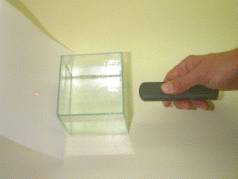
Light Through Milk Fat?

Slide 3
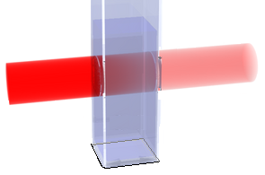
Beer’s Law
some of the light
When shining
LIGHT through a sample
is absorbed
The amount of light absorbed depends on many factors, including:
COLOR ,
thickness of sample
and
type of material

Slide 4
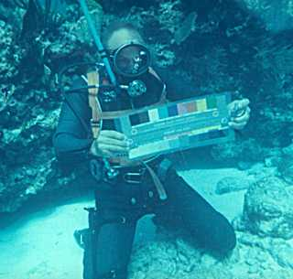
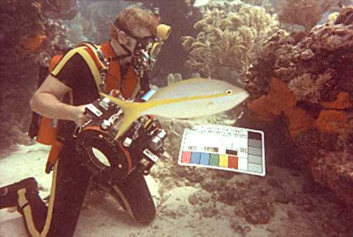
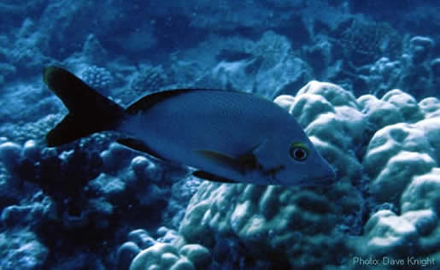
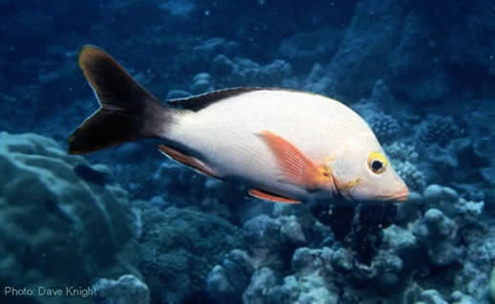
What color does sea water absorb?
mostly the reds!
What if we replace the red light taken from the sun?

Slide 5
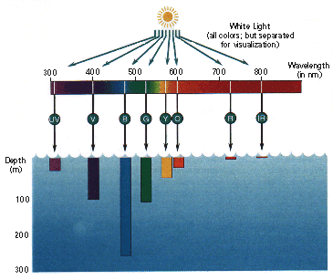
Light absorbed in seawater
Blue is absorbed least

Slide 6
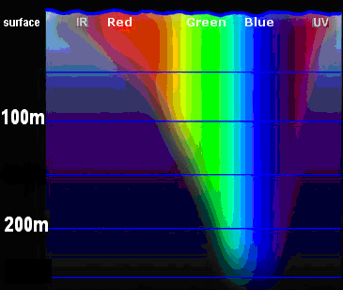
Light absorbed in seawater

Slide 7
So absorption of light is…
…transfer of energy to the medium through which it travels
…described by Beer’s Law
Energy enters as light, but less emerges as it is converted to heat
=
heat energy absorbed
+
light energy in
light energy out

Slide 8
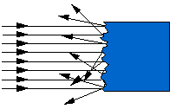
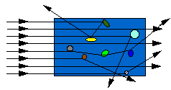
What About Scattered Light?
Scattered light on a surface:
bounces back in all directions.
Scattered light through a solution:
bounces in all directions…
(can you see it)
…so some light makes it through!

Slide 9
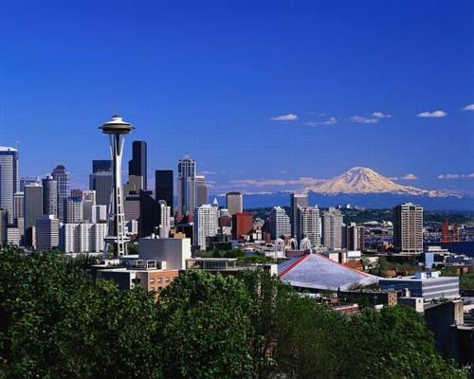
Blue Skies
Come from scattering BLUE light

Slide 10
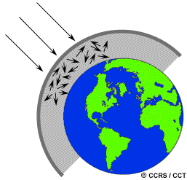
Blue light is scattered the most by the atmosphere

Slide 11
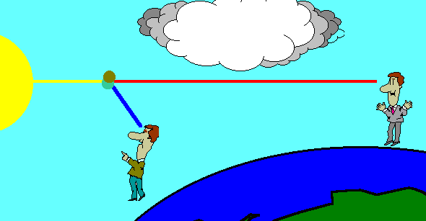
Since blue is scattered most in the atmosphere, sunsets are anything but blue, appearing reddish-orange.

Slide 12
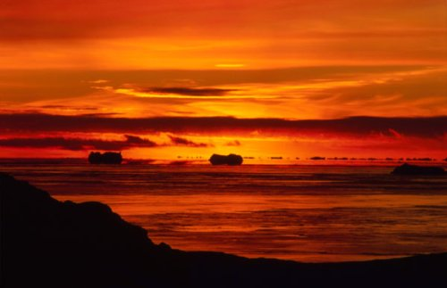
Sunsets are anything but blue

Slide 13
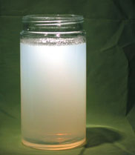
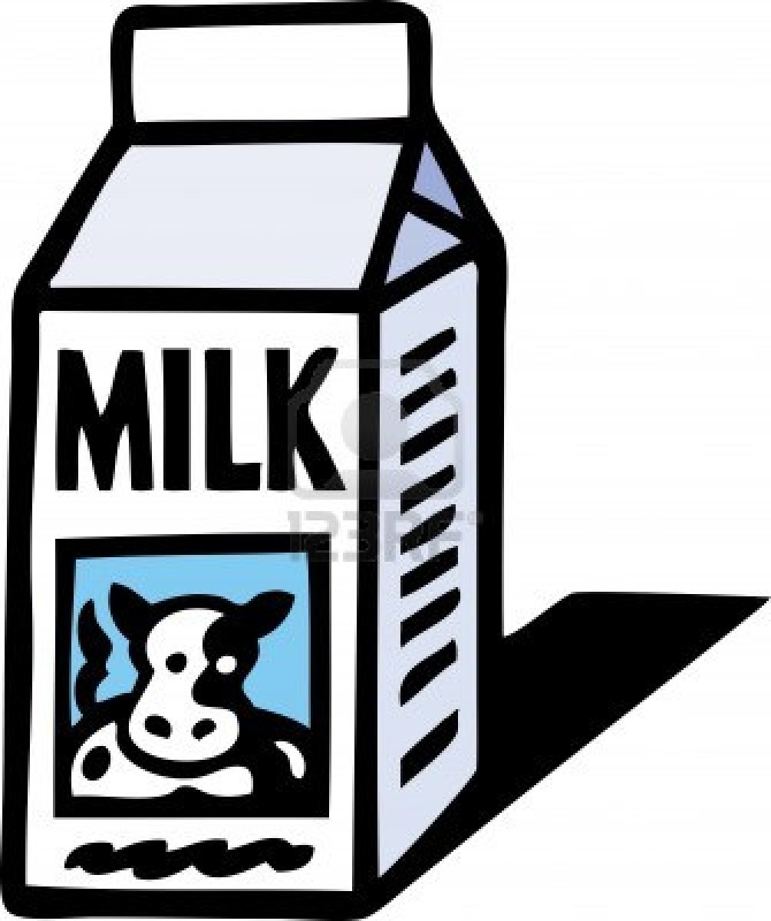
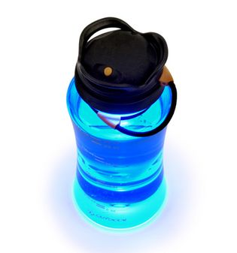
Instead of air in the atmosphere, let’s look at milk fat in water
=
+

Slide 14
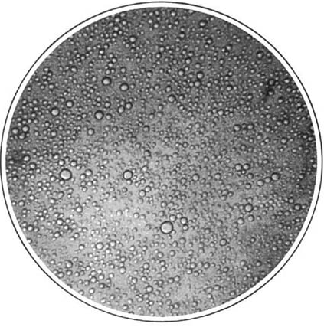
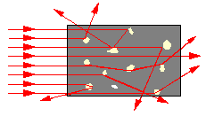
Why Milk?
Homogenized milk contains many small globules of fat
Each mL of 2% milk contains about 10 million globules
…this “population density” is about 10¹⁰ globules/L
0.2 mm diameter FOV
Visible light is scattered nicely by these globules

Slide 15
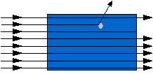
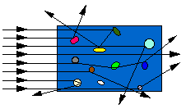
How does the globe population relate to the amount of light scattering?
Higher density of particles leads to more scattering, and less light transmitted through the solution...
low transmission means high concentration

Slide 16
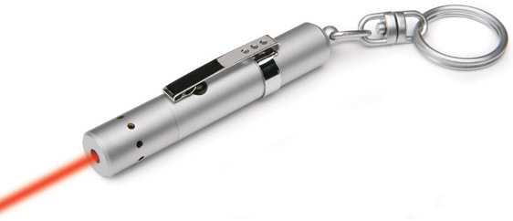
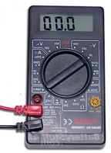
So if we shine a light through a tank with some milk fat…
…and measure the light that makes it through…
light sensor
light
Tank of milk and water
…we can determine the concentration of fat globules!

