Slide 1
Lesson 5 – Observing Beyond our Senses: Inquiry Drives Technology
Driving Question:
How could we use the observed light properties to create an accurate measuring device?

Slide 2
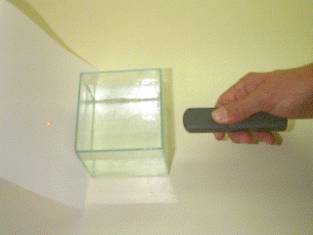
Can we create a measuring device using our observed properties of light?
What would we need to know to determine if our device was accurate?

Slide 3
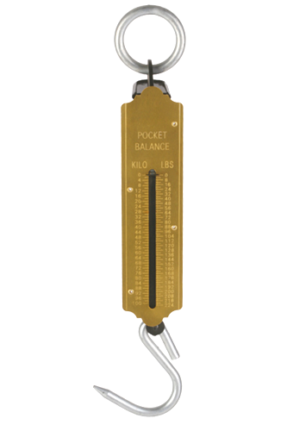
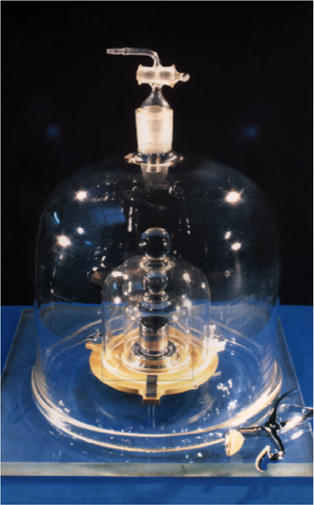
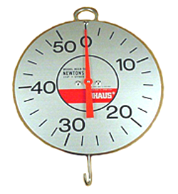
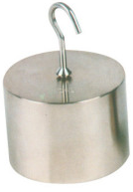
How do we know our spring scales are accurate?
1 kg

Slide 4
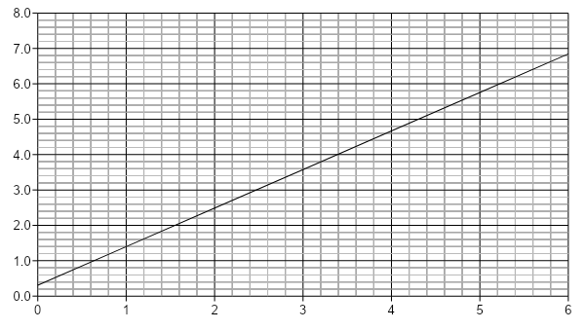
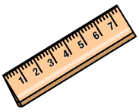
How do we know spring scales are accurate?
stretch (cm)
← offset or “blank”
mass (kg)
1 kg
2 kg
4 kg

Slide 5
How do we know spring scales are accurate?
stretch (cm)
mass (kg)
1 kg
1 kg
2 kg
4 kg

Slide 6
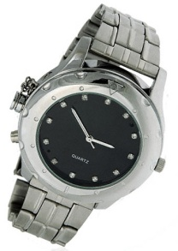
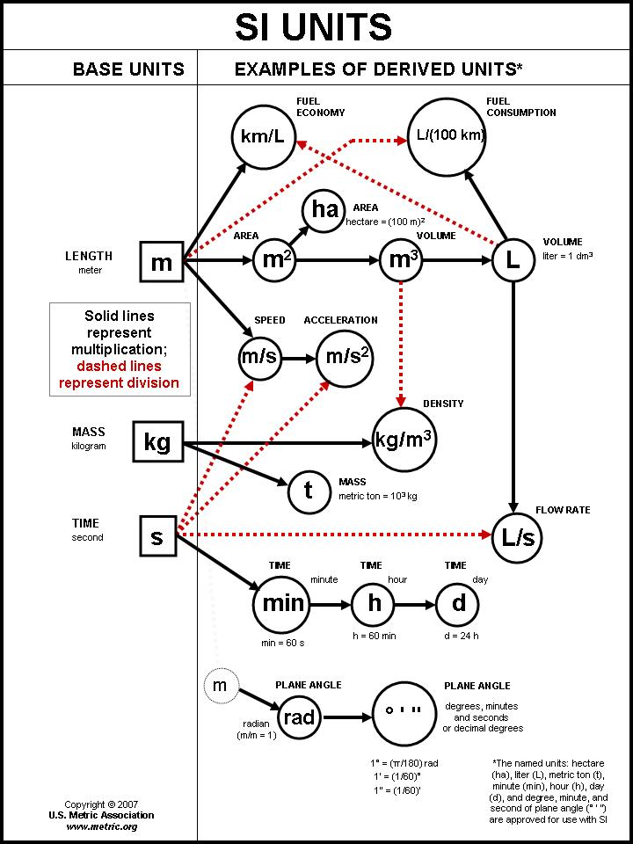
SI Units and time

Slide 7
How do we know spring scales are accurate?
stretch (cm)
mass (kg)
2 kg
1 kg
2 kg
4 kg

Slide 8
How do we know spring scales are accurate?
stretch (cm)
mass (kg)
1 kg
2 kg
1 kg
2 kg
4 kg

Slide 9
How do we know spring scales are accurate?
stretch (cm)
mass (kg)
1 kg
2 kg
4 kg
4 kg

Slide 10
How do we know spring scales are accurate?
stretch (cm)
mass (kg)
1 kg
2 kg
4 kg
1 kg
4 kg

Slide 11
How do we know spring scales are accurate?
stretch (cm)
mass (kg)
1 kg
2 kg
4 kg
2 kg
4 kg

Slide 12
How do we know spring scales are accurate?
Calibration curve
stretch (cm)
mass (kg)
What mass causes a stretch of 5.5 cm?
Stretch = mass (1.13) + 0.60
Final calibration data
= 4.34kg
Mass = (0.55 – 0.60) / 1.13

Slide 13
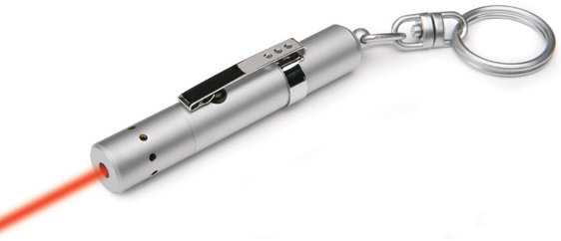
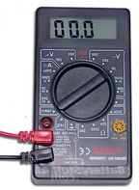
What would we need to know to make an accurate calibration curve for our device?
light sensor
Tank of milk and water

Slide 14
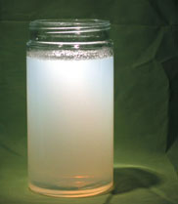
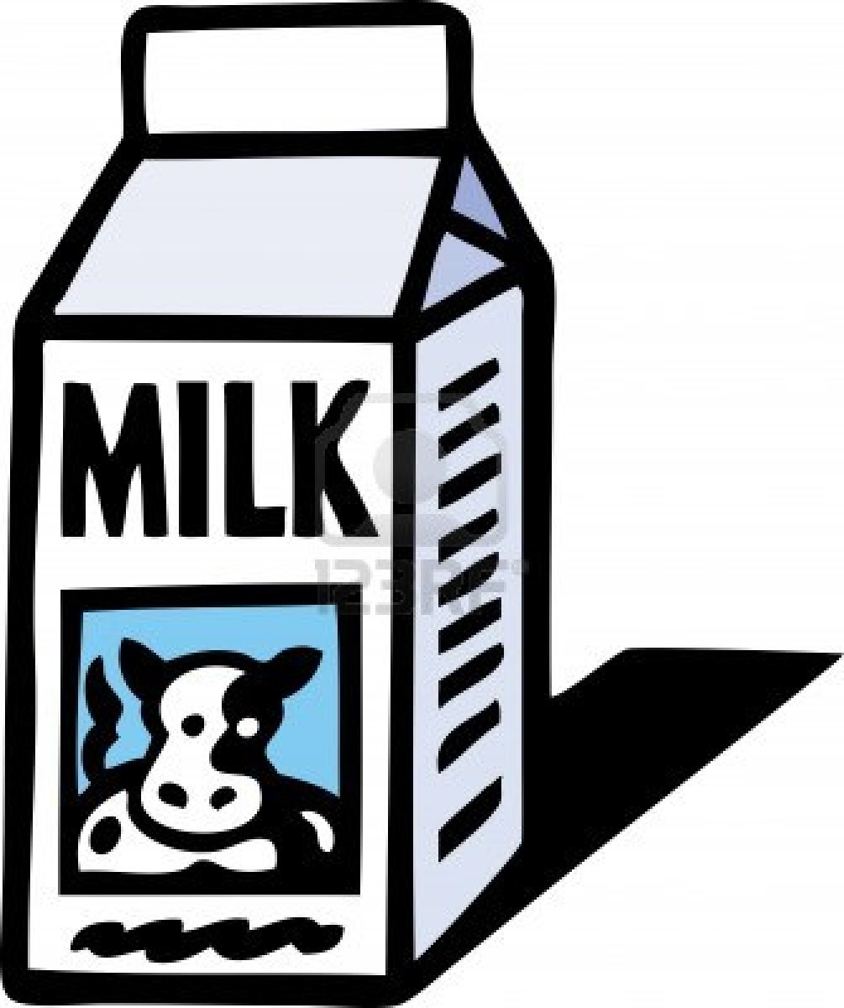
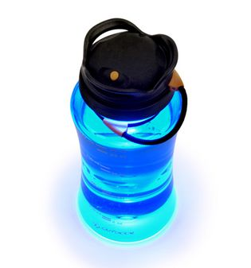
Let’s look at milk fat globules in water
=
+
using serial dilutions

Slide 15
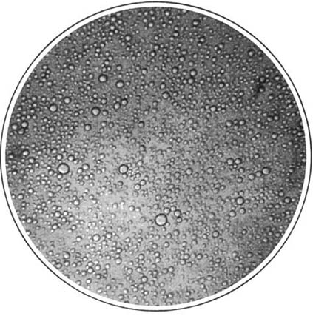
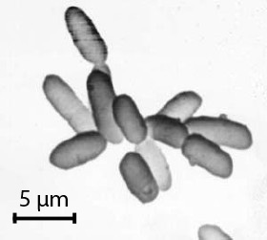
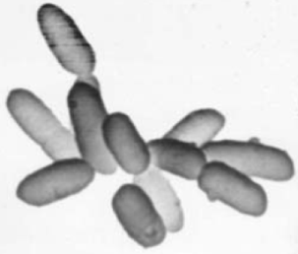
Why Milk?
Homogenized milk contains many small globules of fat
Each mL of 2% milk contains about 10 million globules
0.2 mm diameter FOV
…this “population density” is about 10¹⁰ globules/L
Which is the size of many extremophile microbes we’ll be looking for.
About 10 μm diameter glob is a big one
Visible light is scattered nicely by these globules, about 5 μm across on average

Slide 16
Or perhaps build and calibrate a device with a test tube holder, a light, and a light sensor. Photoresistor LED light source Insert test tube with microorganism sample here

Slide 17
The intensity of light that is transmitted decreases when the milk fat density. . .
…what would our measurements be?
(photoresistor
voltage)
What will the graph look like?
(millions of globules per liter)

Slide 18
Will the calibration curve be similar for all devices utilizing the same properties of light?
Will the calibration curve be similar for all devices utilizing the same parts?
What’s the real worth of measurements done without calibration?

