Slide 1
Inferences from Proxy Variables (Mock AFM)
Lesson 3 - Observing Beyond our Senses: Inquiry Drives Technology

Slide 2
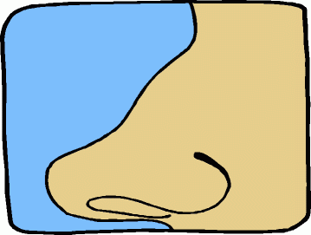
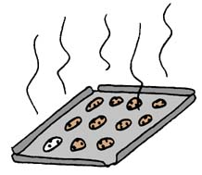
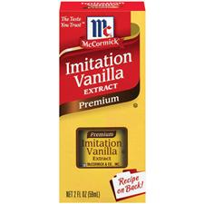
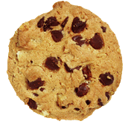
Describe what you smell.
This is an observation:
Noting some fact or occurrence in the natural world
~ ~ ~ ~ ~ ~ ~
What do you suspect this means?
This is an inference:
A logical conclusion based on evidence

Slide 3
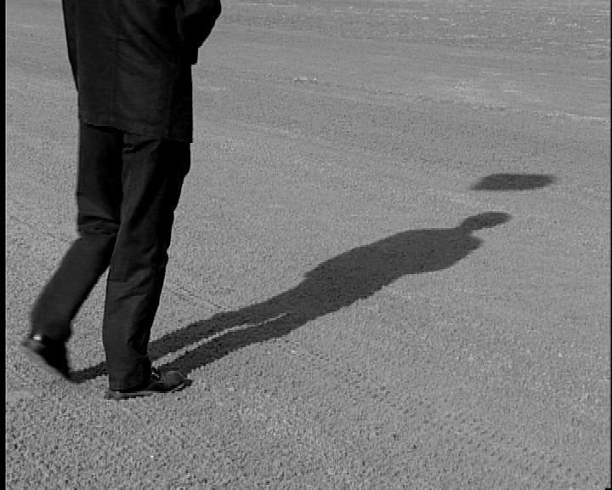
Given this light and shadow data, make observations then an inference. What’s under here?

Slide 4
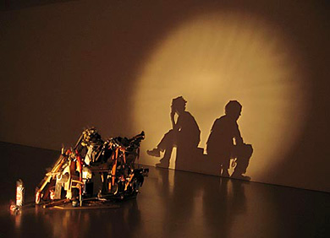
Given this light and shadow data, make observations then an inference. What’s under here?

Slide 5
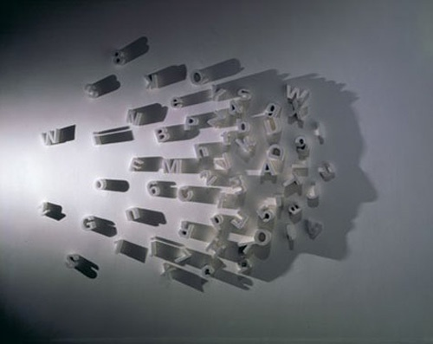
Given this light and shadow data, make observations then an inference. What’s under here?

Slide 6
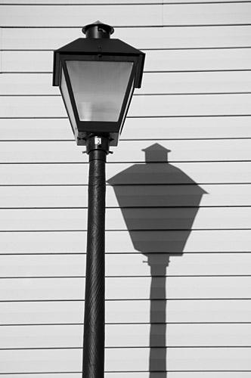
Given this light and shadow data, make observations then an inference. What’s under here?

Slide 7
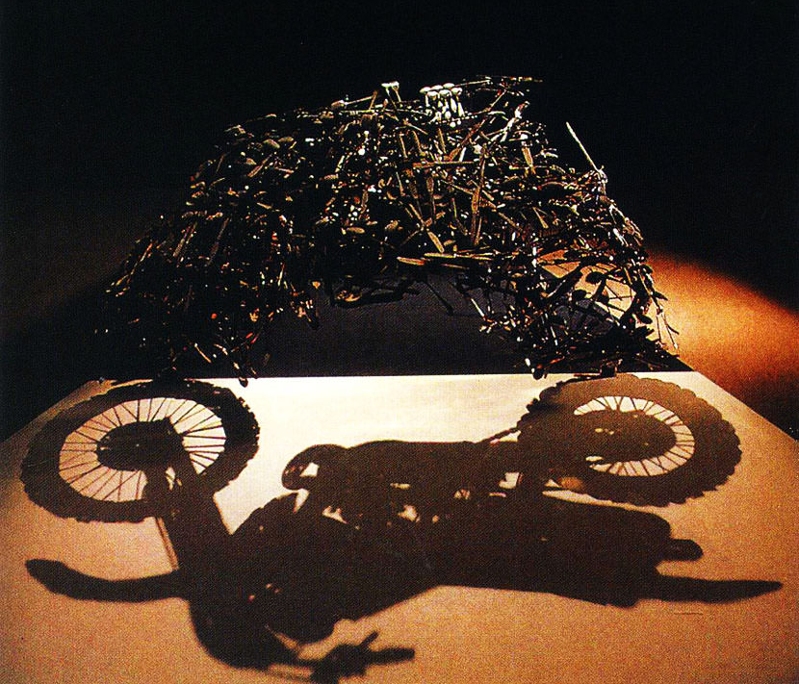
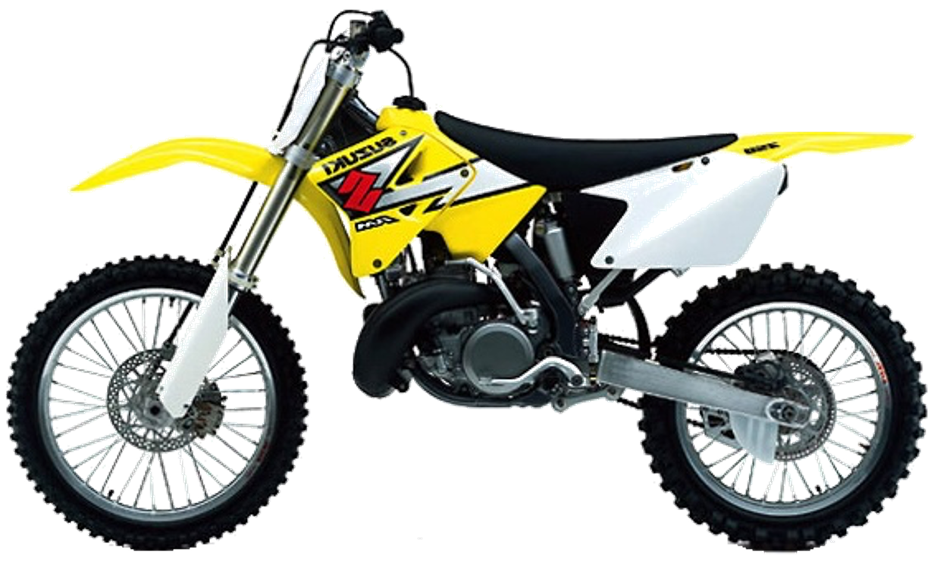
Given this light and shadow data, make observations then an inference. What’s under here?

Slide 8
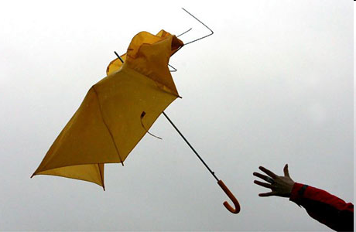
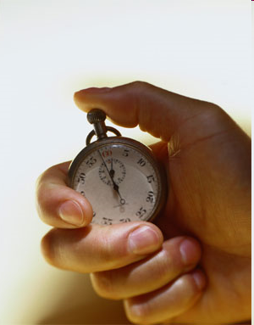
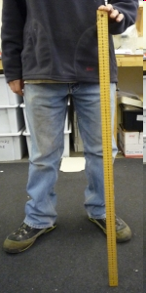
Did You Measure Wind Speed?
What Observations Did You Make?
What Inferences Did You Make?
What were the benefits / limitations of observing “proxy variable(s)”?

Slide 9
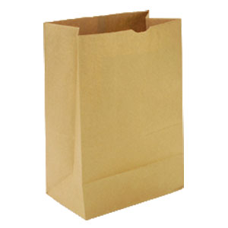
How can we record observations about things not visible to us?
?
Record observations about the object in the bag drawn to the best of your abilities.
No peeking!
Do not make any inferences as to the type of object, just take data.

Slide 10
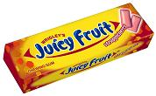
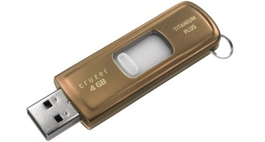
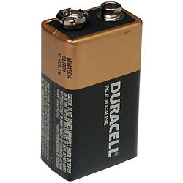
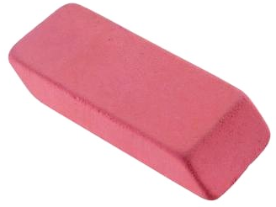
How did you make observations?
Trade drawings and make an inference about what the object is.
Given more information about the possibilities, can you make a better inference about what the object is?

Slide 11
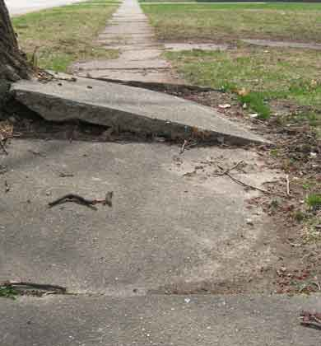
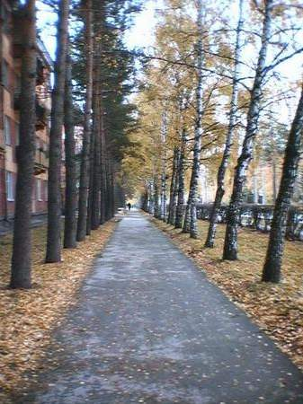
How could you infer the shape of the sidewalk ahead without visual observations?

Slide 12
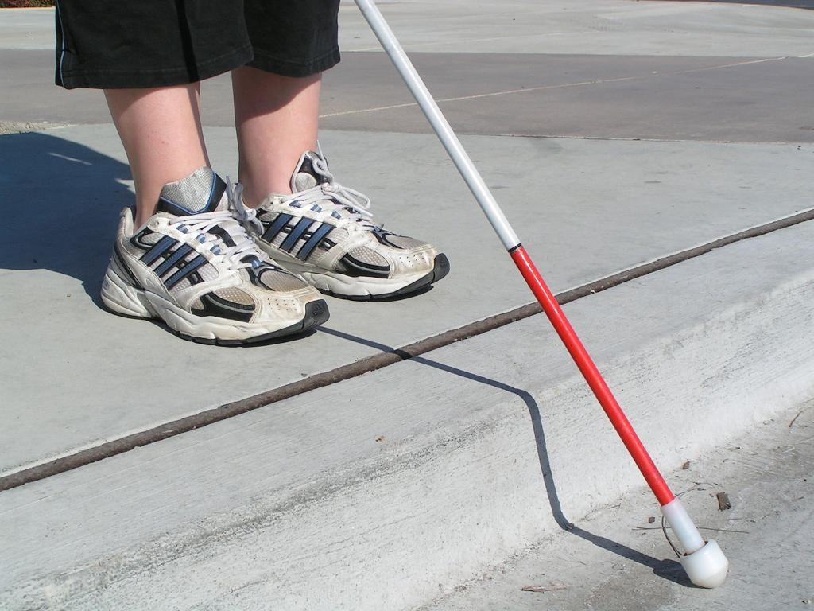
Using my cane to probe the ground…
I can infer that there is a curb in front of me!

Slide 13
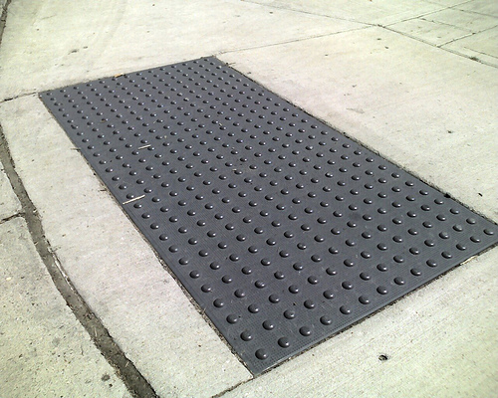
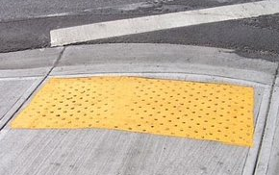
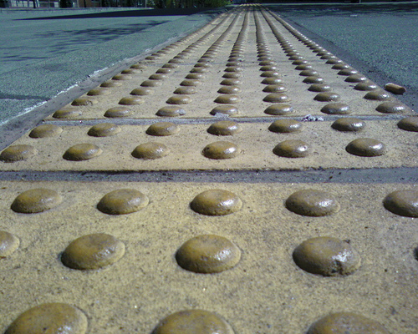
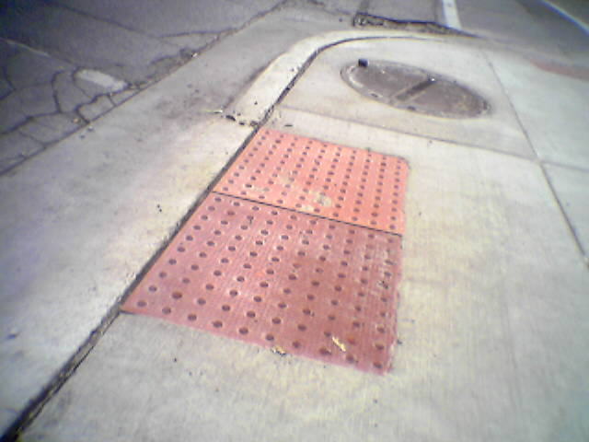
How can these surfaces support inferences from non-visual observations?

Slide 14
In science, we often need to see things that are very small.
But microscopes and
magnifiers only help so much…
...so we need to find other characteristics that allow us to “see” things and make inferences.

Slide 15
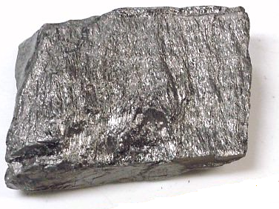
What about smaller scale probing?
These atoms of carbon are way too small for any microscope to help me see...
So how can I infer how the atoms arranged?
(like the carbon in my pencil)

Slide 16
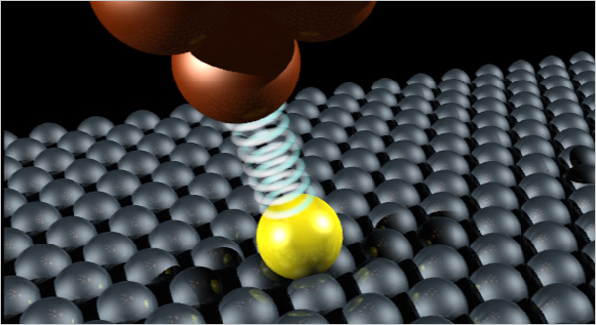
Use a smaller “cane” to probe the “streets and sidewalks” of the atomic scale…

Slide 17
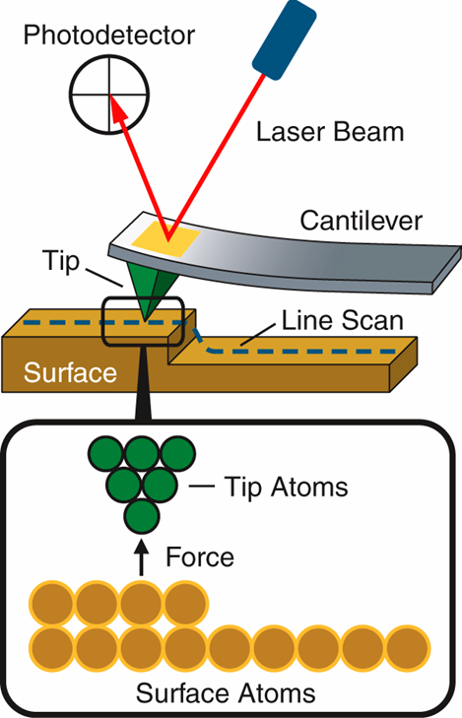
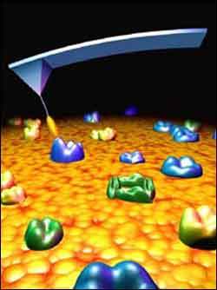
Atoms repel each other…
…so a fine tip will push back when you press it against others atoms.
push

Slide 18
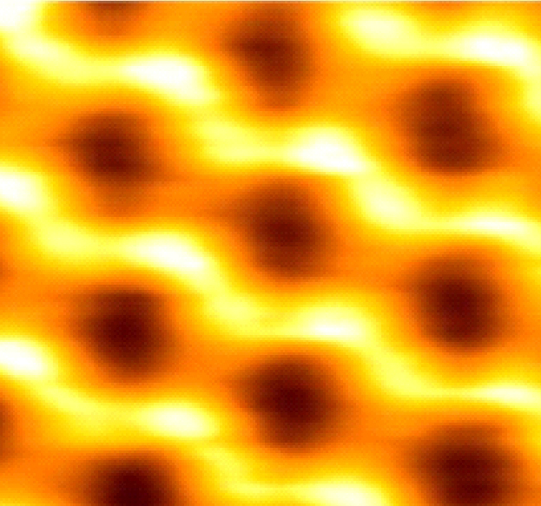
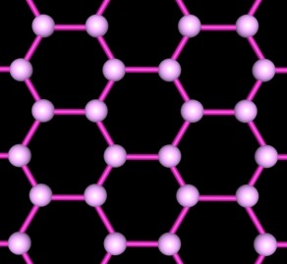
Using the AFM to deduce structure
inference
Graphite
AFM image
computer processing
Deduced Structure:
Hexagonal arrangement of carbon atoms!

Slide 19
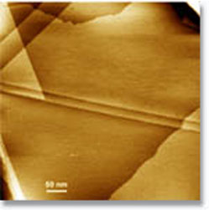
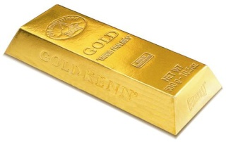
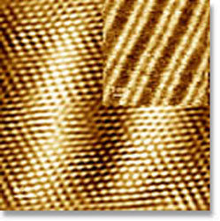
Look at gold’s surface
Each “step” is a layer of gold atoms
Low resolution scan of gold surface, showing atomic steps.
Scan size: 500 nm (0.5 μm)
High resolution scan of gold surface with strips (inset).
Scan size: (inset) 20 nm
High resolution scan of gold surface hexagonal atomic structure. Scan size: 5 nm

Slide 20
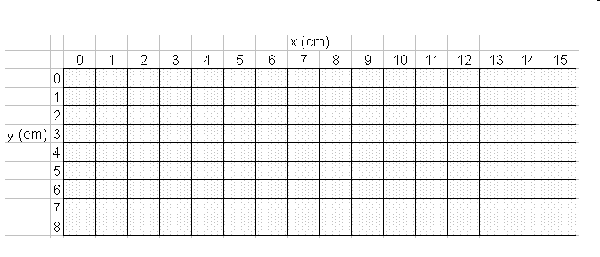
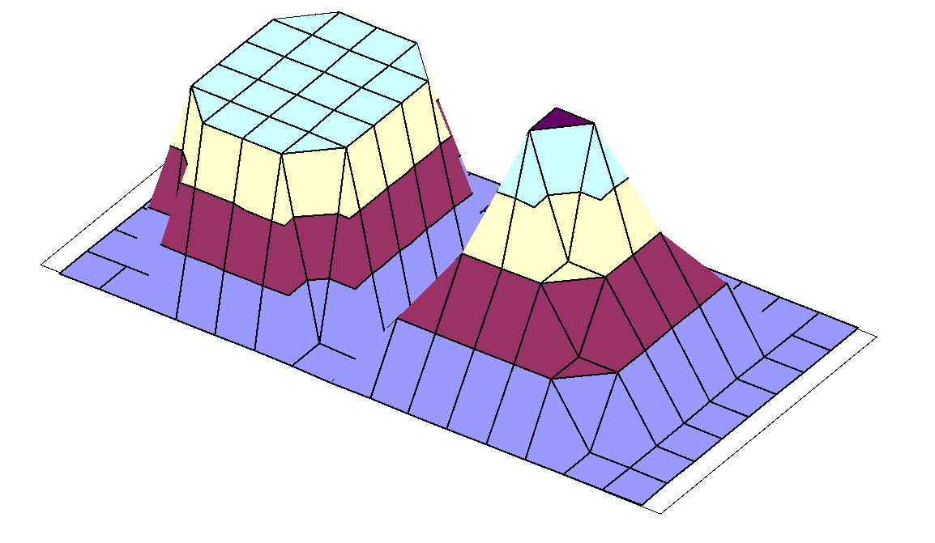
Building an AFM
1)Sample in dark box with small holes on top for a test “stick”
2)Move stick along holes and record height (z) with location (x,y)
3)Infer 3D shape of sample by graphing data
z
x
y
DATA
graph
Inference!

Slide 21
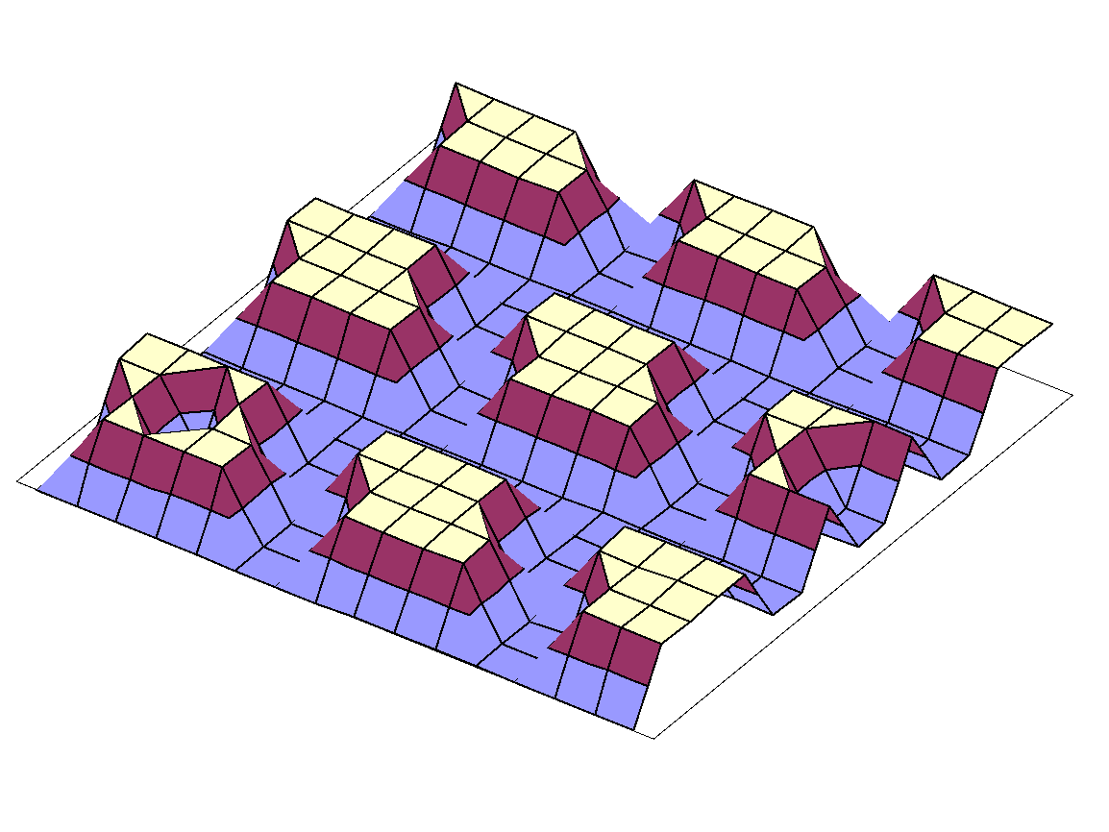
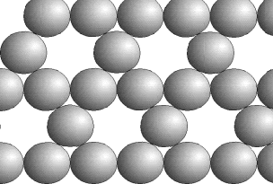
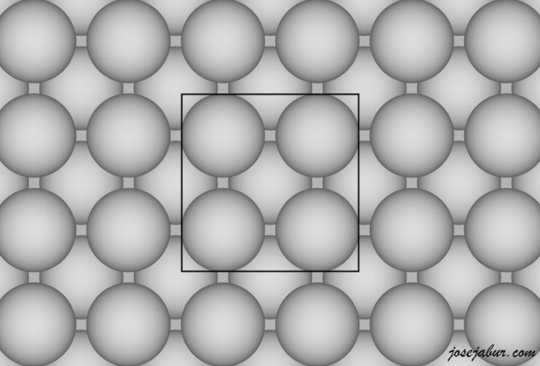
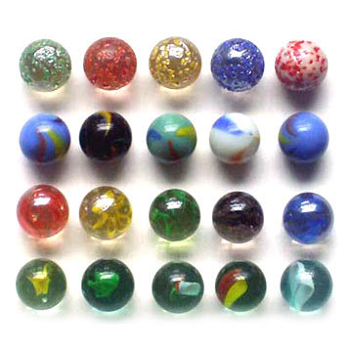
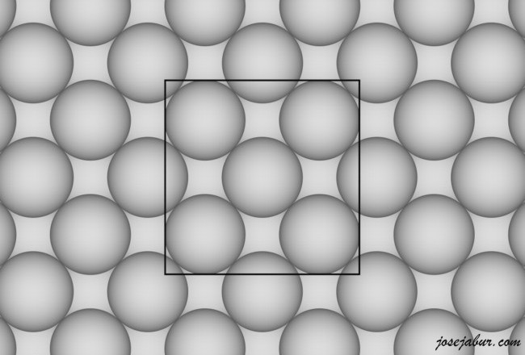
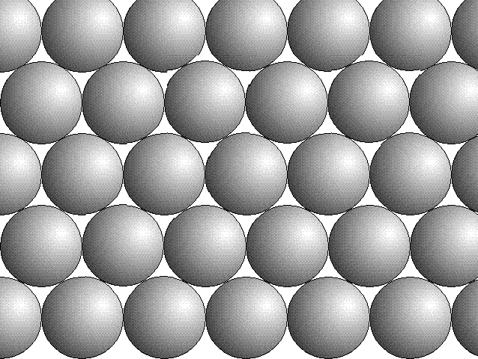
What could this data imply about structure?

Slide 22
What could be done to improve the design of our mock AFM?
Resolution
Fine v. coarse structure

Slide 23
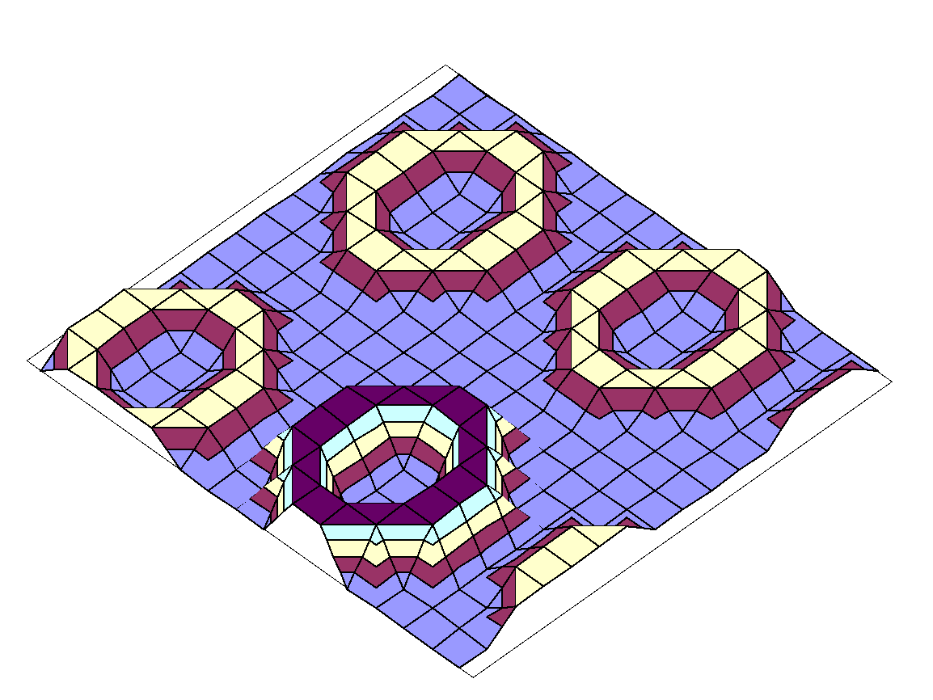
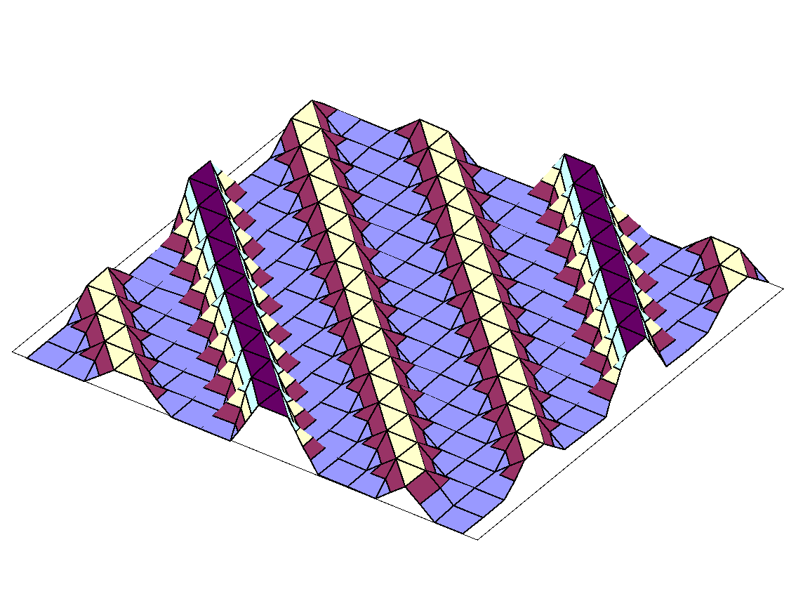
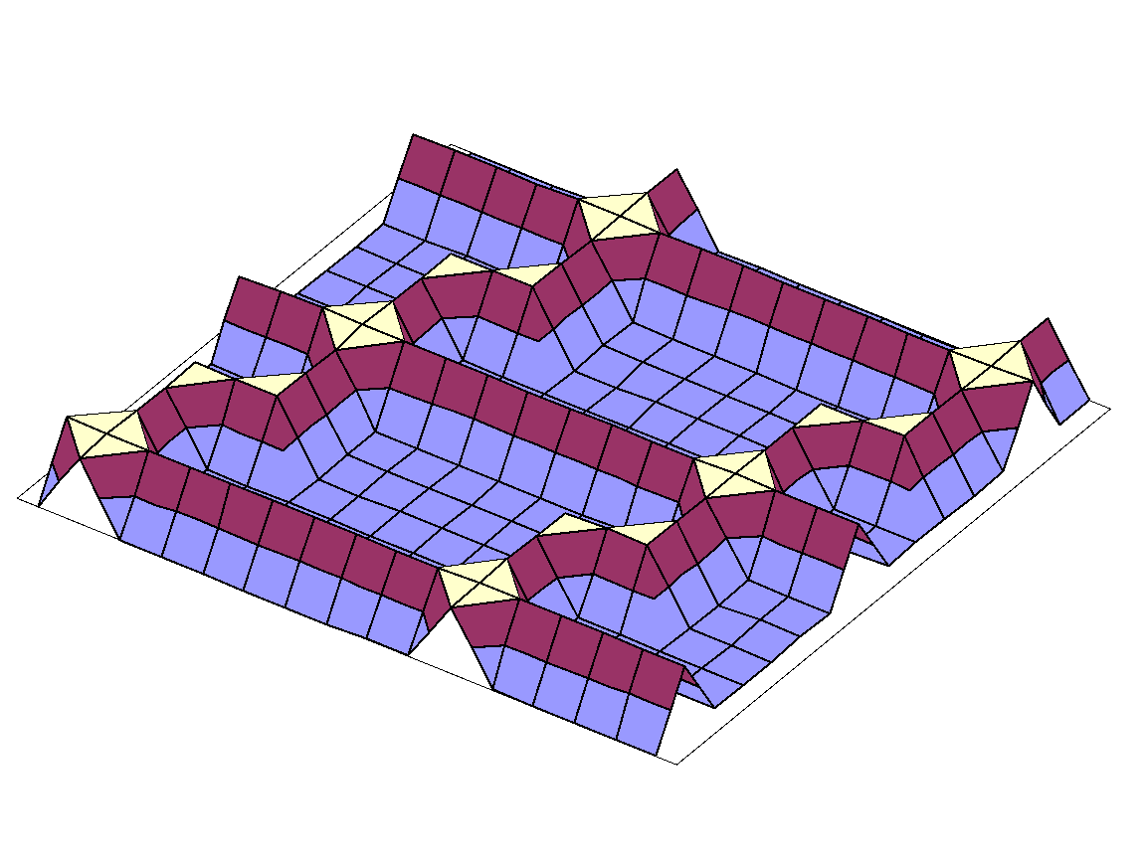
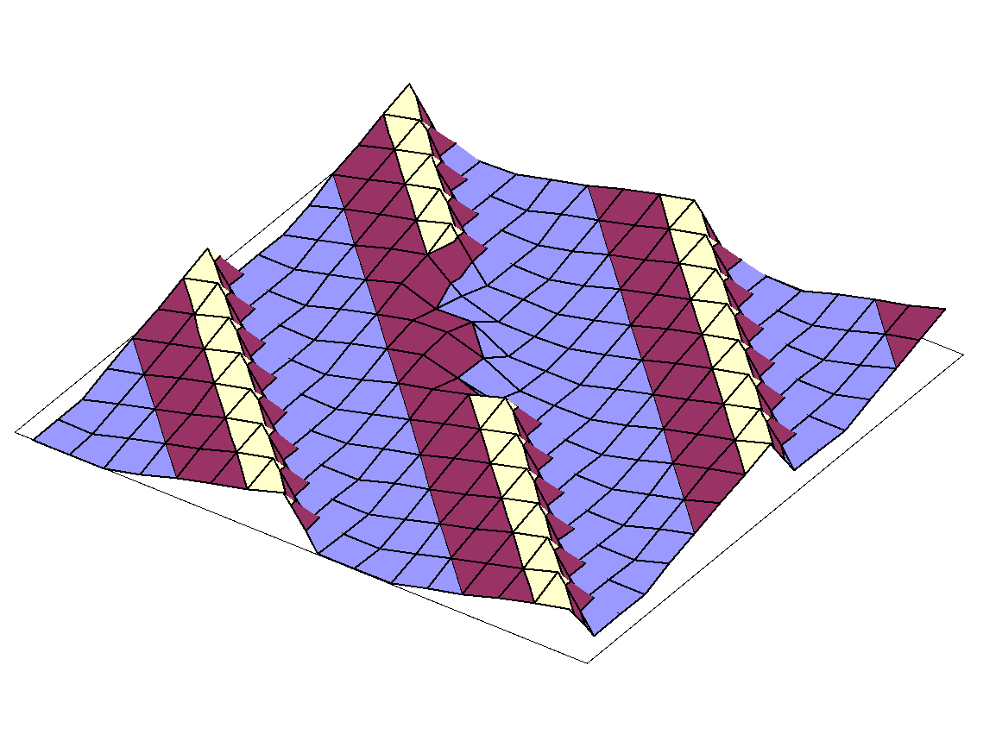
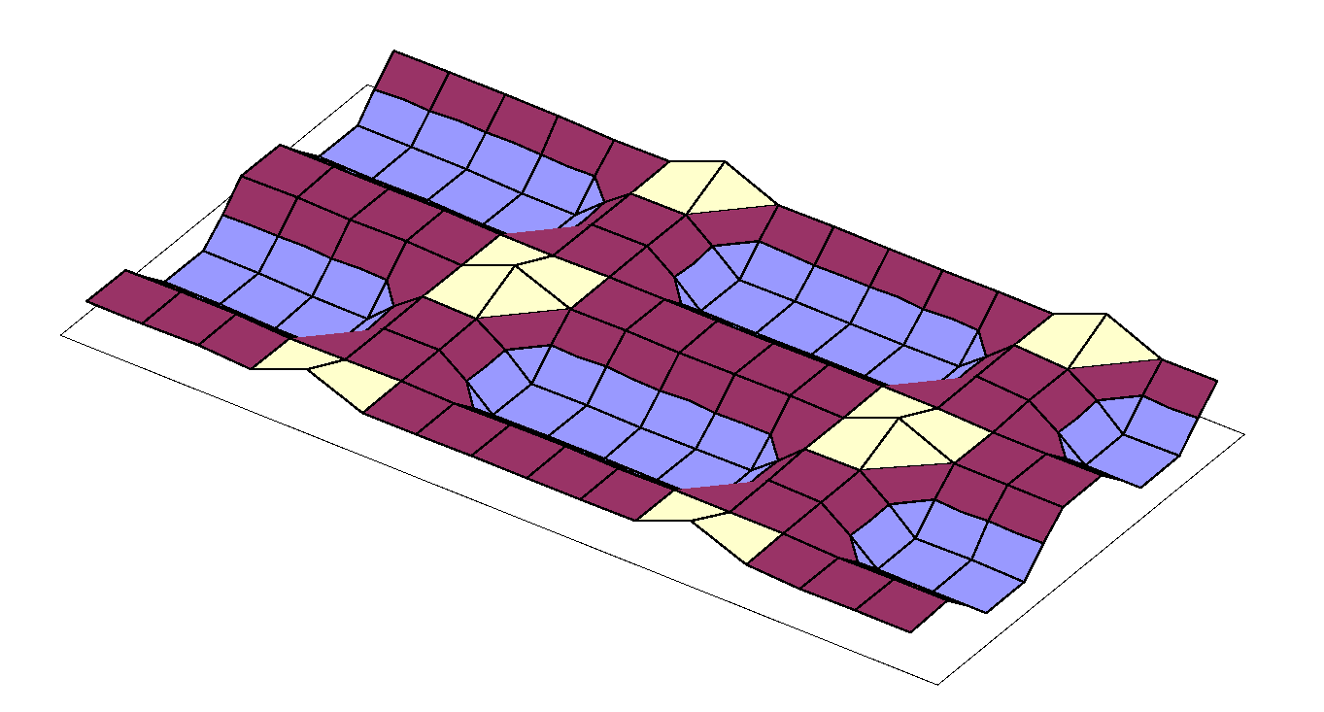
These are possible structures after graphing in Excel. What could they be?

