Slide 1
Design: Solve a Problem
Lesson 2 - Observing Beyond our Senses: Inquiry Drives Technology

Slide 2
What is Design?
Criteria:
Standards with which to judge success
Systematic Problem Solving Balancing
Limitations on possible solutions or problems
Constraints:

Slide 3
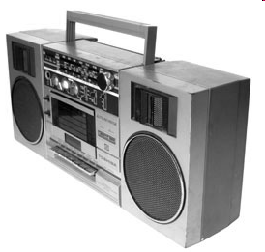
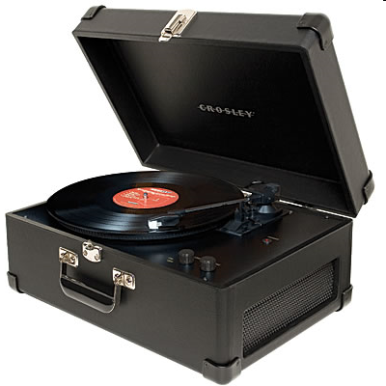
For the iPhone, what were possible criteria the designers were trying to meet?
Constraints?

Slide 4
Design: An Iterative Process
Define the Problem Or Need
Identify Criteria & Restraints
Devise A Plan
Research
Brainstorm Solutions
Weigh Tradeoffs
Evaluate & Refine
Test & Interpret Data
Recommend Improvements
Communicate
Results
Carry Out Best Approach

Slide 5
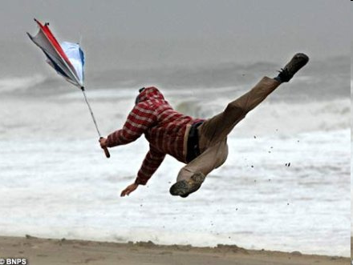
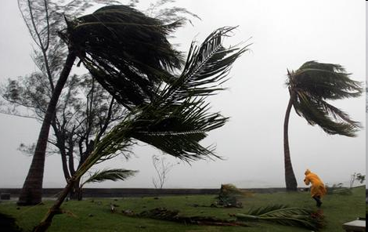
Measurement Challenge
Design a method to measure wind speed

Slide 6
Record the following
Statement of the Problem
Identified Criteria
Identified Constraints
Brainstorm as many solutions as possible with your group.

Slide 7
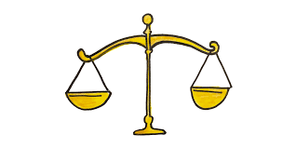
Be sure to… RECORD EACH STEP!
Weigh tradeoffs
Choose an approach
Calibrate it
Measure and unknown

Slide 8
To Calibrate & Then Measure Unknown Wind Speeds:
Use a standard box fan
Your teacher has measured the wind speed at 3 distances from the box fan.
Then, use your device to measure the wind speed of an unknown fan at 3 different distances
Report your measurements to your teacher, and compare them to the actual values.
Evaluate your device.

Slide 9
To calibrate & then measure unknown wind speeds:
Use a standard box fan
Your teacher has measured the wind speed at 3 distances from the box fan.
Then, use your device to measure the wind speed of an unknown fan at 3 different distances
Report your measurements to your teacher, and compare them to the actual values.
Evaluate your device.

Slide 10
Evaluate Your Results
Did You Meet Your Criteria?
What are the next steps?

Slide 11
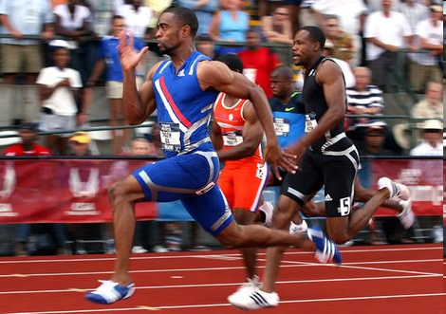
Final Thoughts: Legal Wind?
World Records for certain Track & Field events are denied if the assisting tailwind exceeds +2.0 m/s during the event.
Could your design be used to measure the wind speed for Track & Field events?
How would your identified design criteria have to change?
Tyson Gay ran the fastest 100m (9.68s) at the 2008 US Olympic Trial Finals—but was kept out of the record books by a 4.1 m/s tailwind

