Slide 1
Observing Beyond our Senses: Inquiry Drives Technology
Lesson 1 – High Saline Environment and Extremophiles

Slide 2
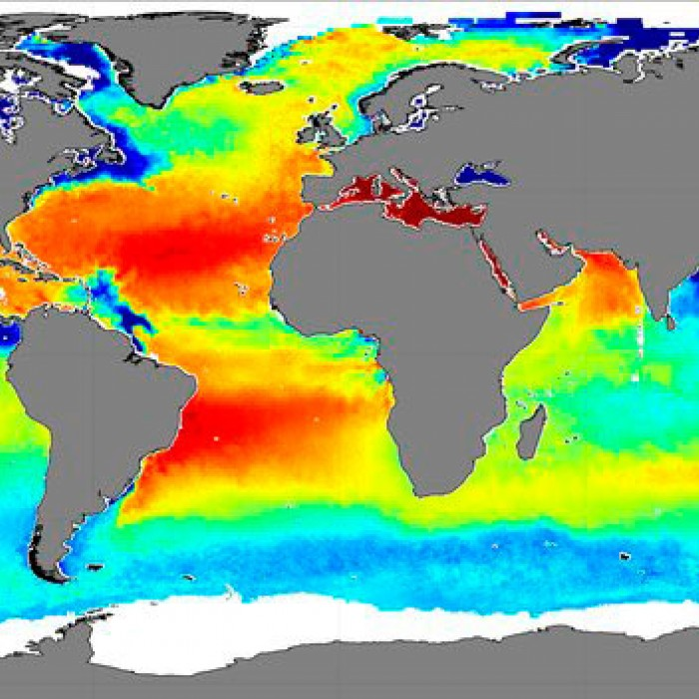
It may surprise you to learn that the ocean is not equally salty everywhere.
The Puget Sound is one of the least salty parts of the ocean. One of the saltiest areas is the Red Sea. Why?

Slide 3
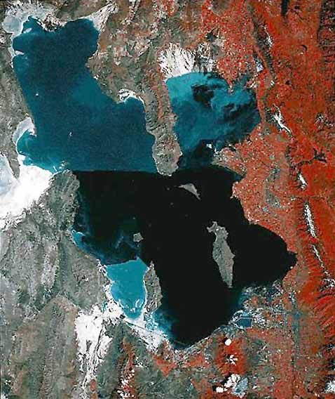
Satellite Photo of the Great Salt Lake
Actively growing vegetation
The north end of the lake is quite shallow, and mostly isolated from the south end by a railroad causeway. Why is it a different color?
And why are those smaller areas in the south also light blue?

Slide 4
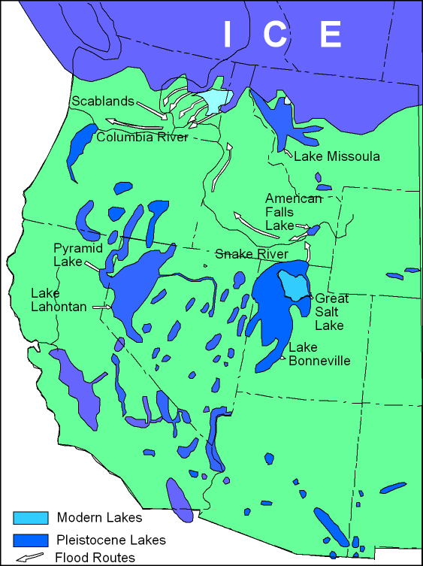
The Great Salt Lake has changed significantly in the last 50 years
But that’s nothing, compared to how it’s changed over the last 30,000 years.
Check out this animation

Slide 5
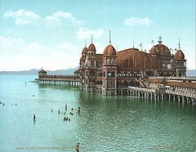
SaltAir Pavilion
In the 1980’s, increased mountain runoff resulted in rising lake levels that inundated shoreline features such as highways, railroads, marinas, and the SaltAir Pavilion.

Slide 6
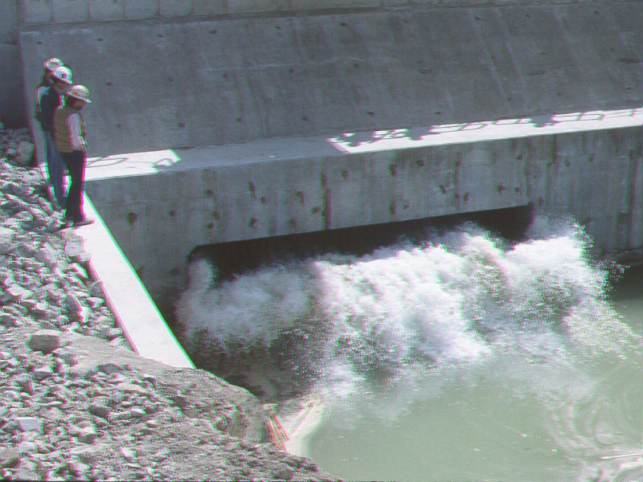
SaltAir Pavilion
A management plan was put into place to pump excess water into a dry Western Basin, where it could evaporate safely.
Notes:
A management plan was put into place to pump excess water into a dry Western Basin, where it could evaporate safely. The lake’s thick mixture of mineral salts has proven to be corrosive to pumping equipment.

Slide 7
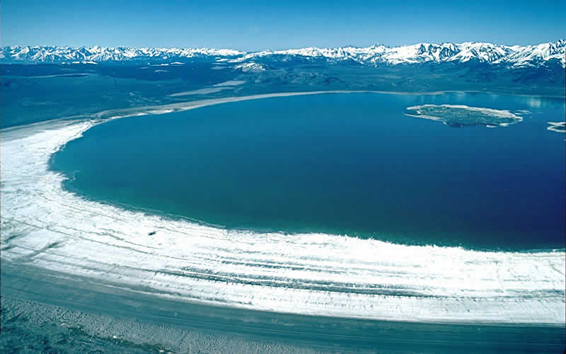
Mono Lake, East California
Mono Lake gets continually saltier due to water collection by the City of Los Angeles.
Notes:
This is Mono Lake in eastern California. It is even saltier than the Great Salt Lake, and the City of Los Angeles, 1,000 miles away, collects the water that would otherwise refill the lake. Over the last 80 years, the level of the lake has dropped more than 50 feet.

Slide 8
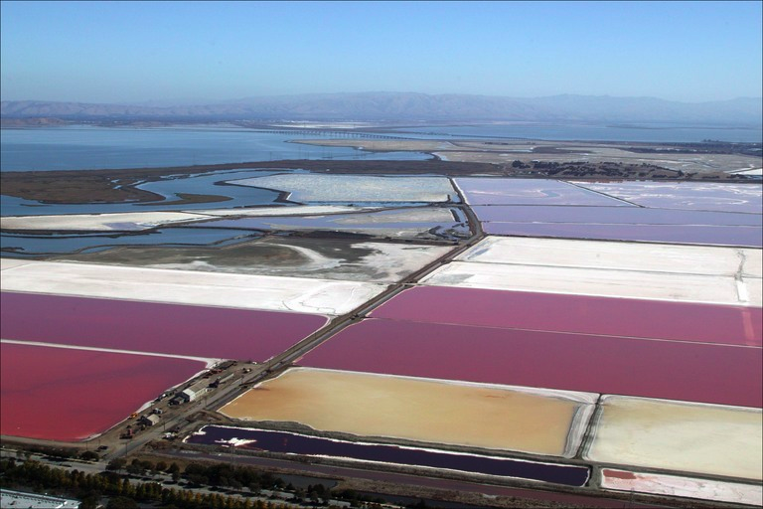
Salt Farming Technique
Salt farmers encourage evaporation with shallow ponds.
Different water sources leave behind different mineral salts.
Notes:
In many sunny parts of the world, salt is extracted from water by encouraging evaporation using shallow, closed off ponds.
Over weeks and months, the water evaporates into the atmosphere, leaving behind salt. Depending on the water source, the dried salt is a mixture of many different kinds of mineral salts, not just NaCl (sodium chloride).

Slide 9
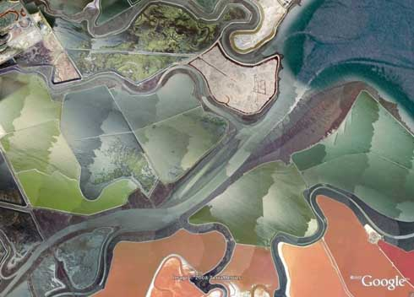
Salt Farming Technique
This estuarine landscape has been completely transformed by salt mining. Estuarine: where freshwater runs into the ocean.
Notes:
In these photos, you can see estuarine landscapes fully transformed by humans mining sea salt. Sea salt is an important nutritional source of iodine, often lacking in the diets of rural people living far away from oceans. Iodine deficiency produces serious health effects such as hypothyroidism, or goiter.

Slide 10
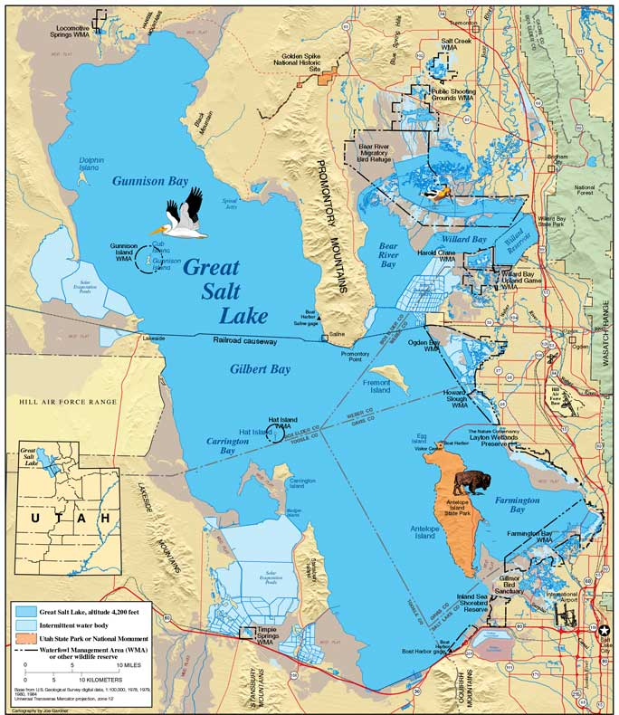
The light blue discolored areas in this map are evaporation ponds.
The Great Salt Lake is an important commercial source of K₂SO₄ (Potassium sulfate), a fertilizer.

Slide 11
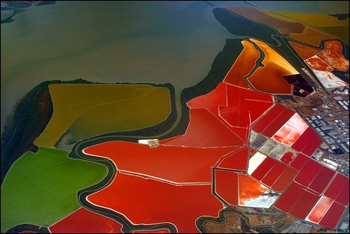
Halophiles
Halophiles are extremophiles which thrive in extremely salty environments.
The discoloration in this pond is due to a reddish pink halophile.
Notes:
Notice the color difference in these evaporation ponds. The color comes from an extremophile microorganism which can survive and flourish in extremely salty environments.

Slide 12
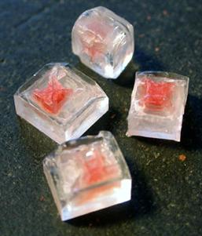
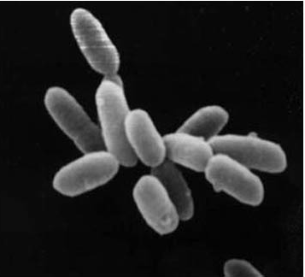
Halobacterium salinarum
A reddish pink flagellated Archaea
Can survive in high salinity environments (up to 25% dissolved salt)
Notes:
Halobacterium salinarum is a flagellated microorganism responsible for the red tint in evaporation ponds. Despite its name, it isn’t a bacteria, but a member of an even older group called Archaea. In the picture to the left, it’s growing on and within salt crystals, tinting them red. “Halo” can grow in water with up to 25% dissolved NaCl. Its relatively simple genome has been fully sequenced.

Slide 13
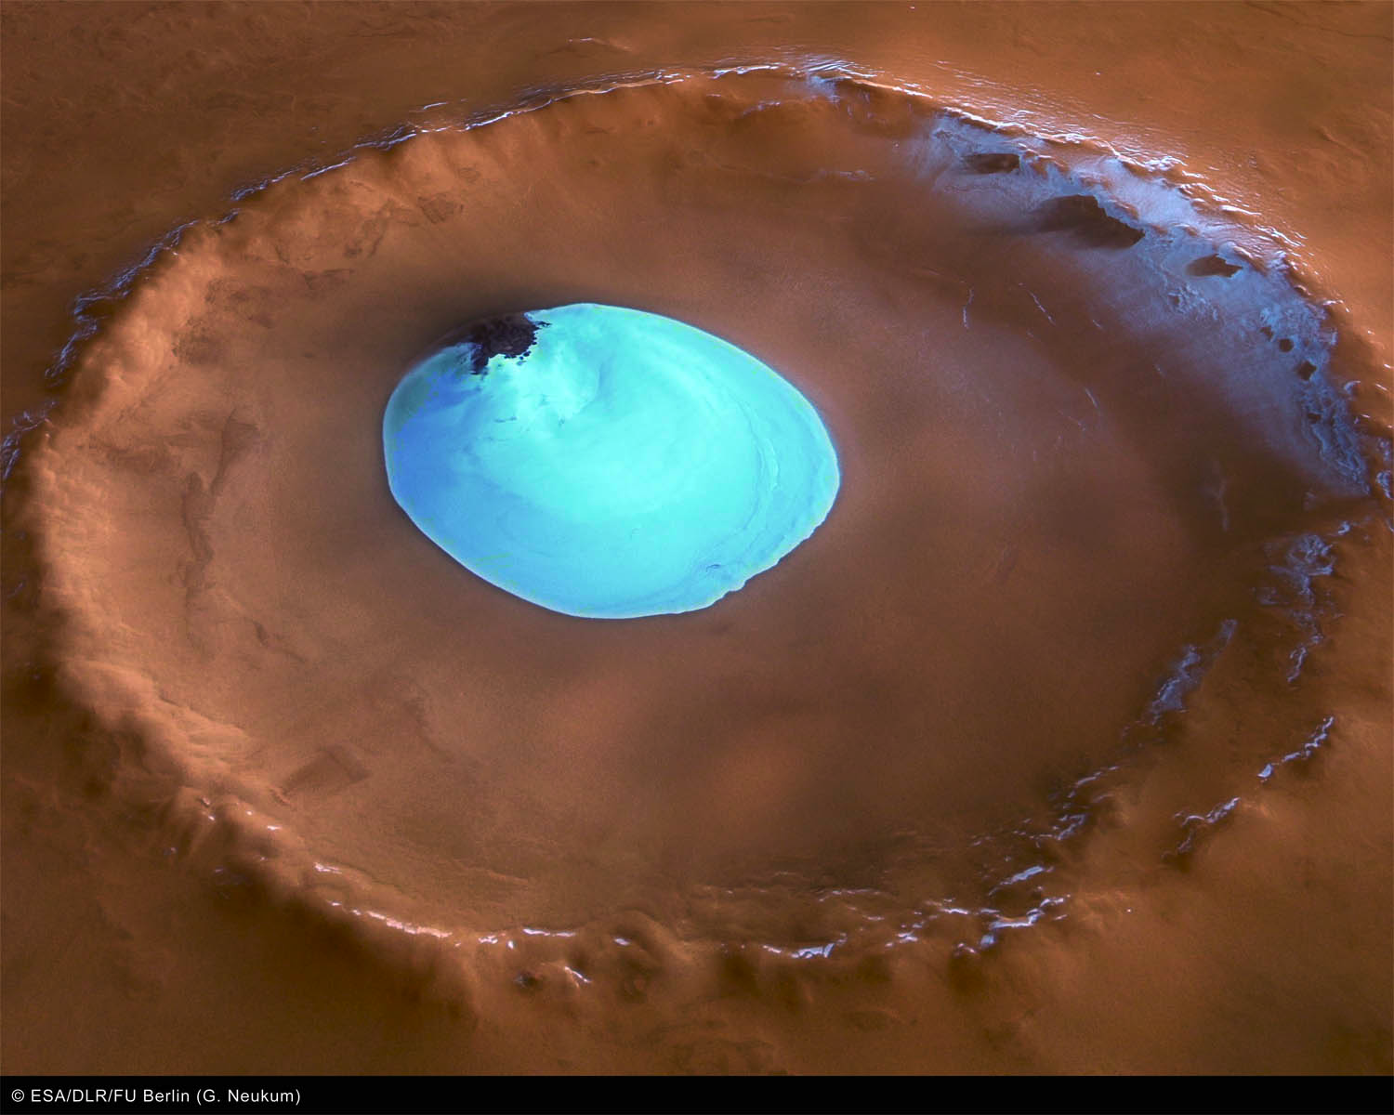
Deposits in Space
This Martian crater has a modern deposit of water ice.
Did it hold a lake at one time? Could it have held life?
Notes:
There are modern but very ancient lifeforms on Earth which survive under similar conditions.

Slide 14
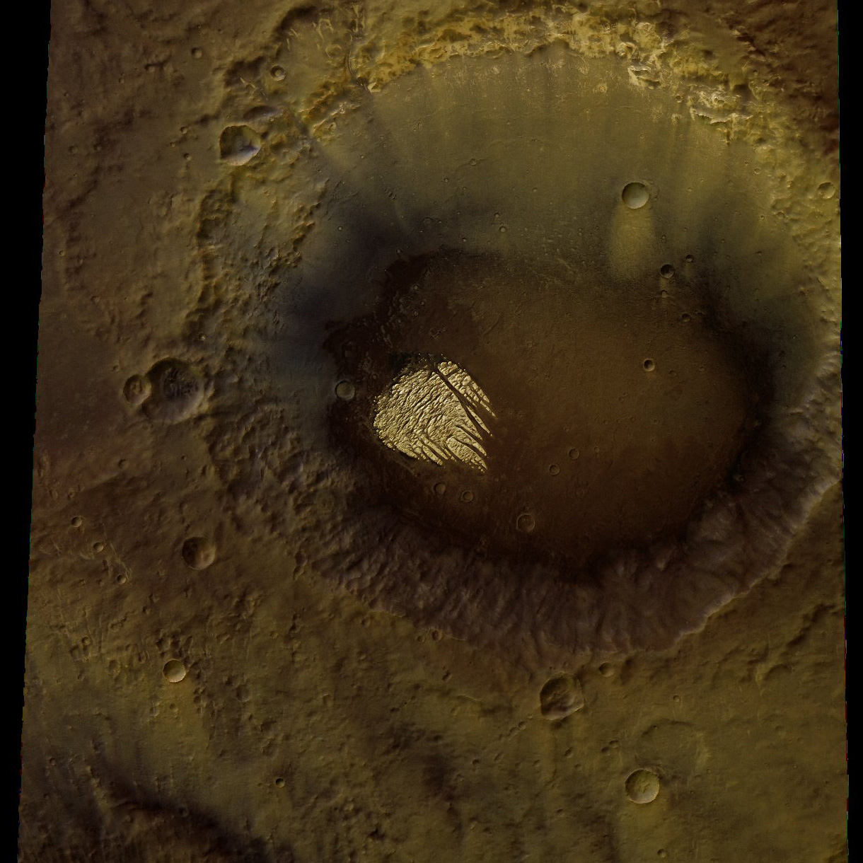
Evaporation Ponds in Space
Evaporites on this Martian crater indicate that there may be liquid water below the surface.
Notes:
Based on appearances, scientists believe that the white deposits on the floor of this Martian crater are some kind of evaporites. The presence of evaporites suggests that there may be liquid water below the surface, trapped between rocks. While this water might be saline, there is a reasonable prospect that Martian life may still be hanging on. If so, we expect that it might resemble our own extremophiles in their biochemistry.

Slide 15
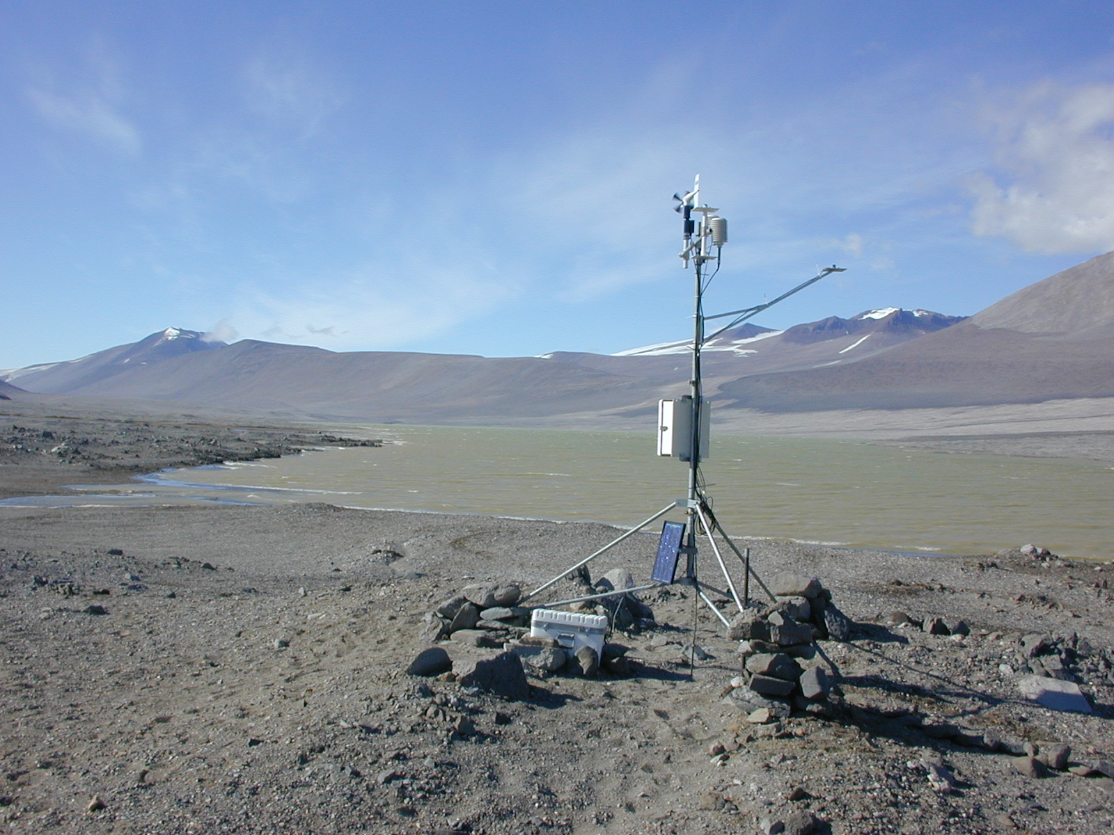
Lake Vida
Similar to Mars, Lake Vida is an Antarctic lake trapped beneath many meters of ice.
Ice frozen from salt water expels salt from its crystals, rendering the water below highly saline.
Notes:
Lake Vida is an Antarctic lake trapped beneath many meters of ice. Ice frozen from salt water expels salt from its crystals, rendering the water below highly saline. Lake Vida and similar lakes in Antarctica have been isolated from the rest of the Earth for thousands or even millions of years. The Lake Vida environment may closely resemble environments on Mars, so microbiologists and astrobiologists are intensively studying the native microorganisms and their biology.

Slide 16
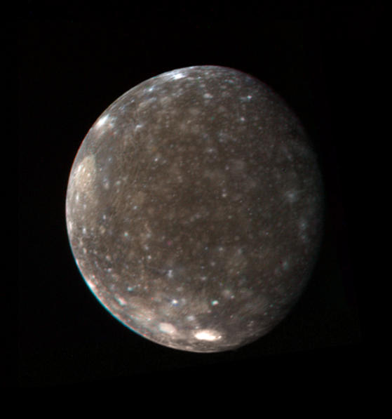
Jupiter’s Moon, Callisto
The electrical activity of Jupiter’s Moon, Callisto, suggests to planetologists that there may be a saline liquid ocean beneath a surface ice layer several kilometers thick.
Is this isolated ocean, completely dark and cut off from photosynthesis, a possible environment for extremophiles?

Slide 17
The Great Salt Lake, and others like it:
Very dynamic systems, appearing and disappearing as precipitation changes
Important environments for extremophiles
Important sources of minerals
Important for tourism and scenic beauty
Extremely vulnerable to accumulating pollutants.
Models for likely extreme environments elsewhere in the universe

Slide 18
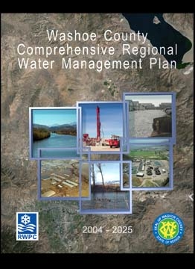
Water Management Plans
Water management plans are essential in areas of low rainfall, especially as populations grow.
Future demands have to be predicted in order to develop such a plan.
Notes:
In low rainfall areas of the world, including the western United States, water is an increasingly critical resource. Many parts of the Western US are not connected by drainage to the ocean, so collect water, runoff, and human-made pollution in saline lakes.
As populations grow, demands increase for water for homes, businesses, parks, and recreational uses.
Most areas have developed water management plans which attempt to match present and future demands with present and future resources.
This plan from the Nevada county where Reno is located describes all the facets of a 21-year plan.

Slide 19
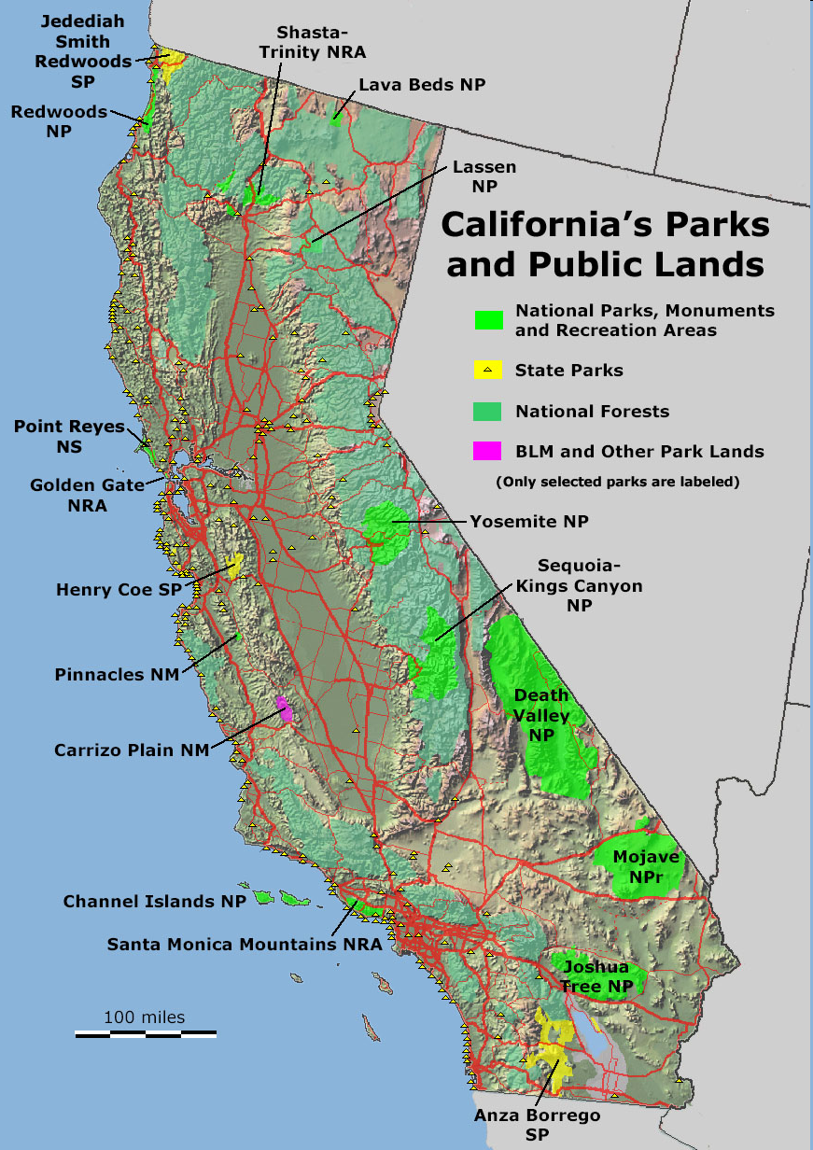
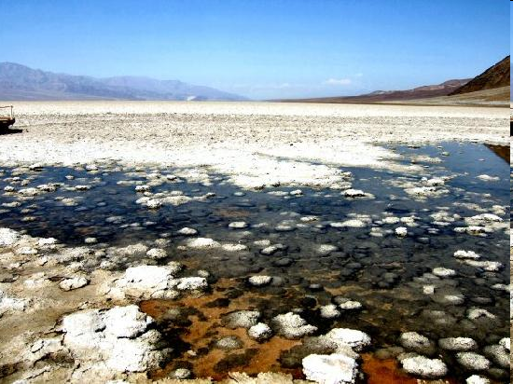
Your Plan: Death Valley Case Study
You will:
Develop a Water Management Plan for Death Valley’s Bad Water Middle Basin
Research In Situ Conditions by Studying Two Indicator Species: Extremophilic Microbes

Slide 20
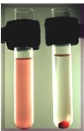
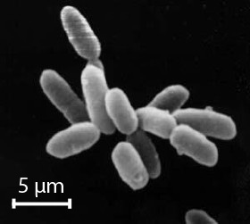
Discussion Questions
How can we measure populations of extremophilic microbes in water samples?
Brainstorm for a few minutes:
What are the challenges?
What might be possible?

